Slide 1


A Survey on Test-Time Scaling in Large Language Models: What, How, Where, and How Well?
Page: https://testtimescaling.github.io/
Presenter: Qiyuan Zhang

Slide 2
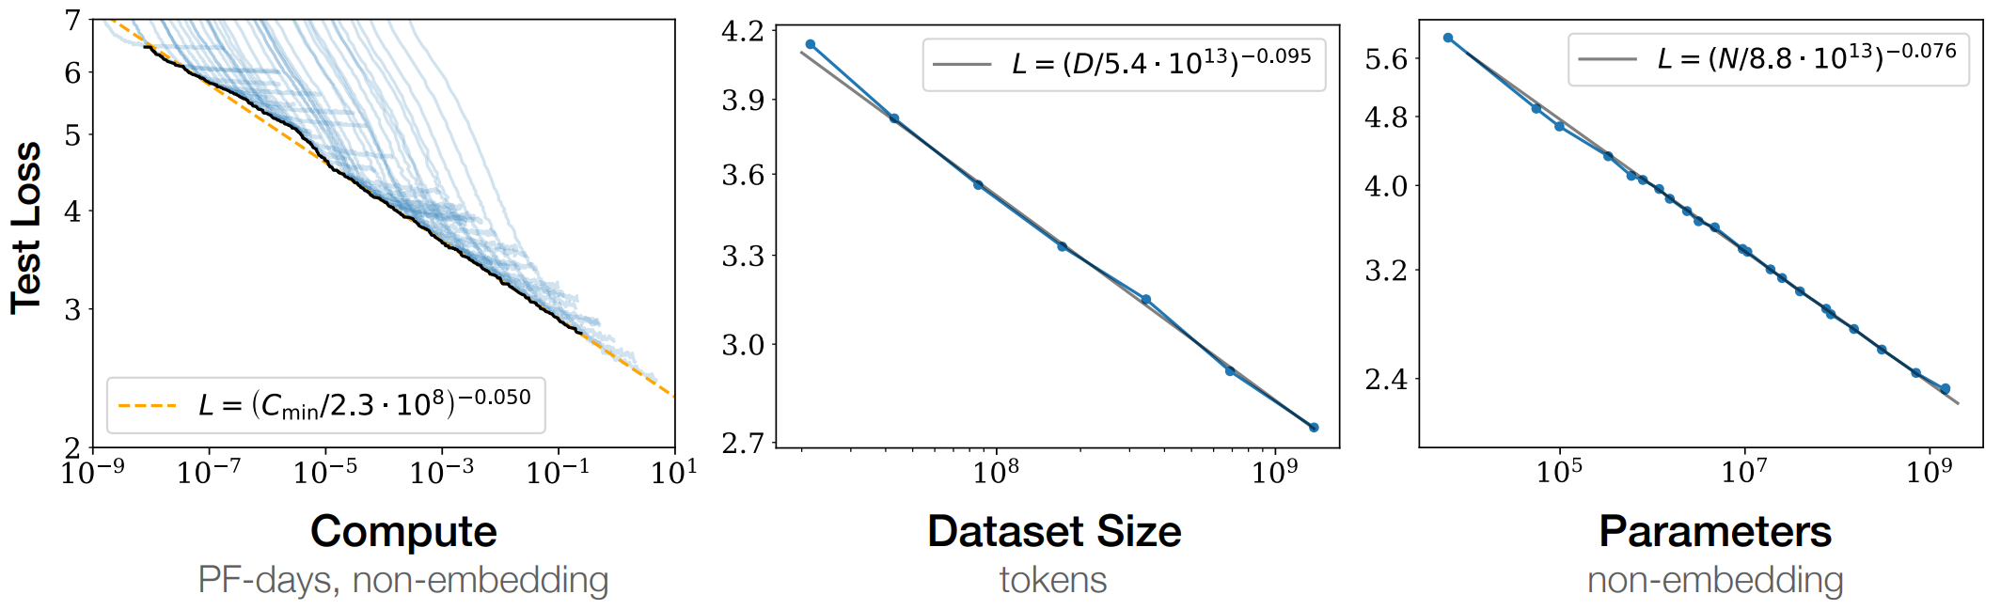
The Age of Pretraining (2020-2024)
[1] Scaling Laws for Neural Language Models

Slide 3
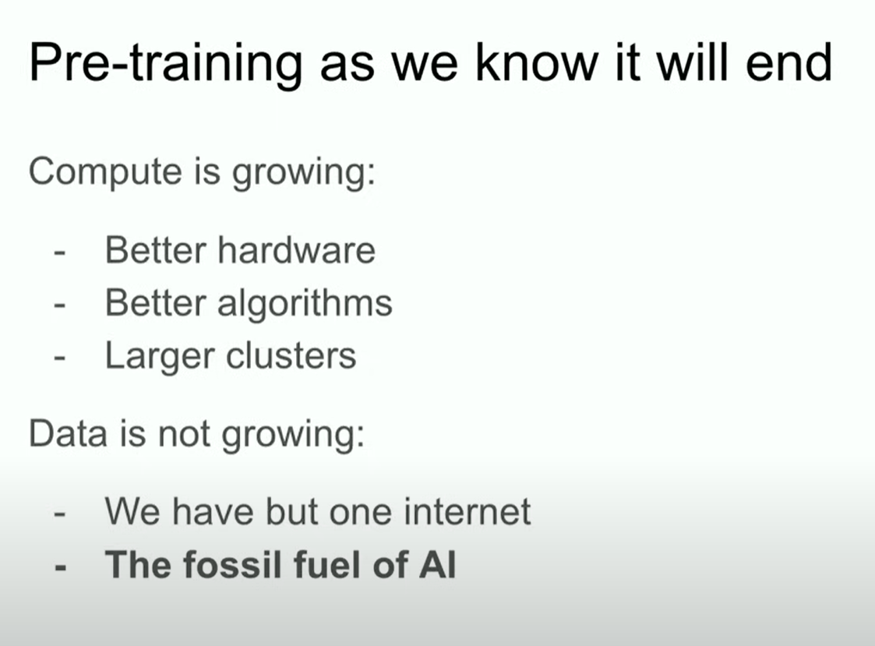
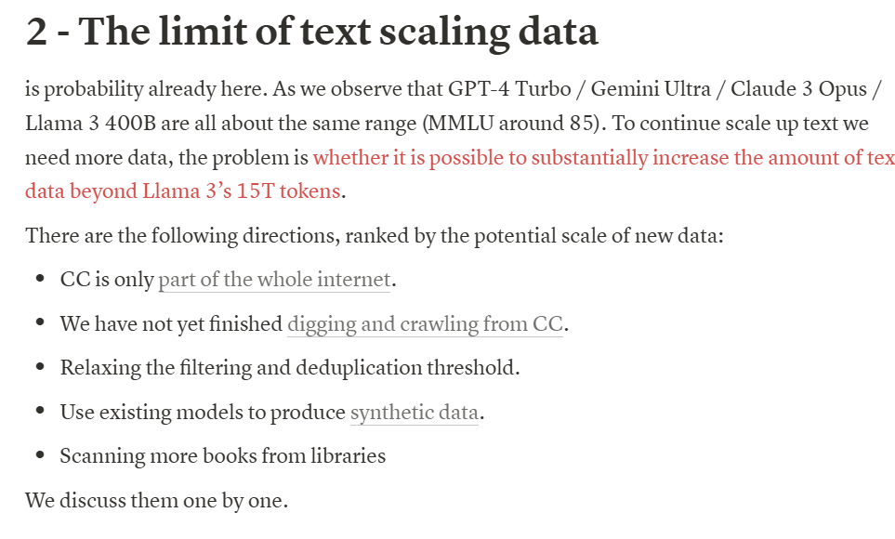
Pretraining scaling has gradually slowed
[2] Fu’s Blog (Apr 2024)
Ilya’s Speech (Dec 2024)
[2] Llama 3 Opens the Second Chapter of the Game of Scale

Slide 4
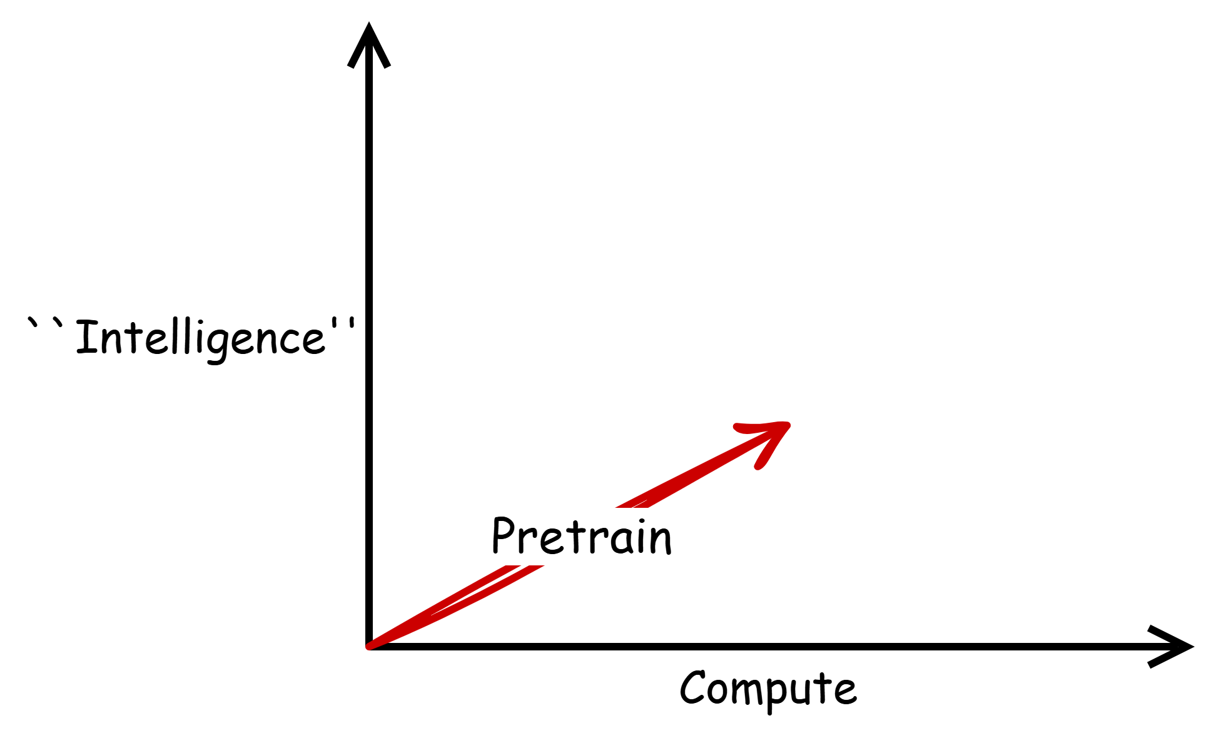
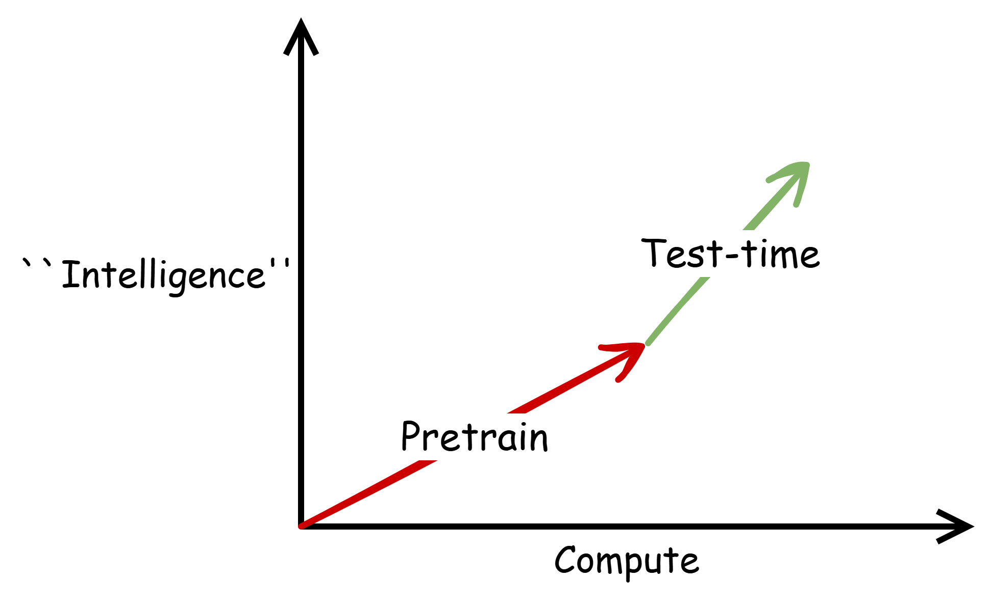
Pretraining
Test-time
Increasing pretraining-time compute yields consistent performance improvements
Increasing test-time compute yields consistent performance improvements
Notes:
这里少一个long cot等

Slide 5
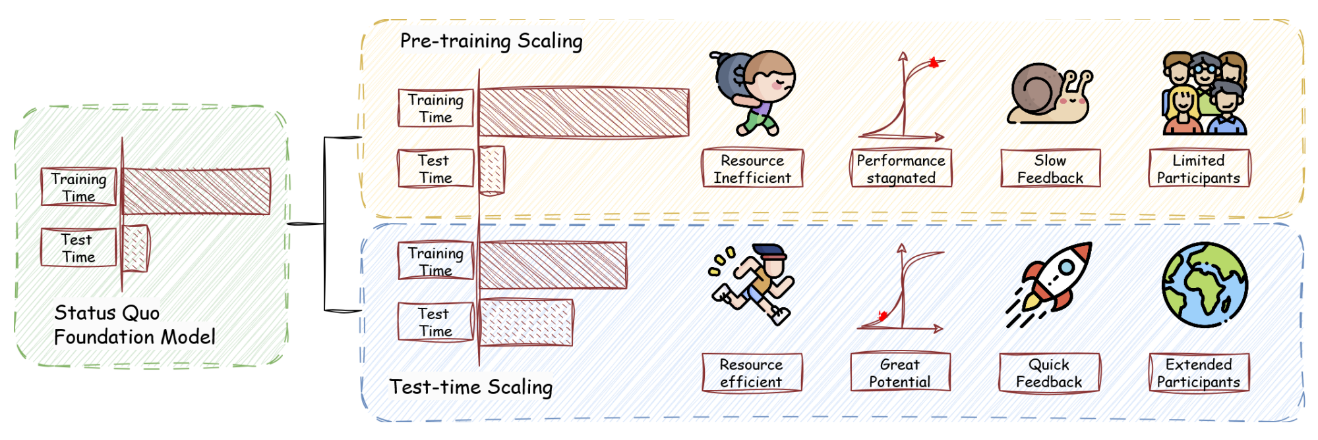
Test-time Scaling
Test-time scaling (also referred to as inference scaling, test-time compute)
progressively elicits the model’s intelligence in the test-time phase.
Comparison of Scaling Paradigms in Pre-training and Test-time Phases

Slide 6
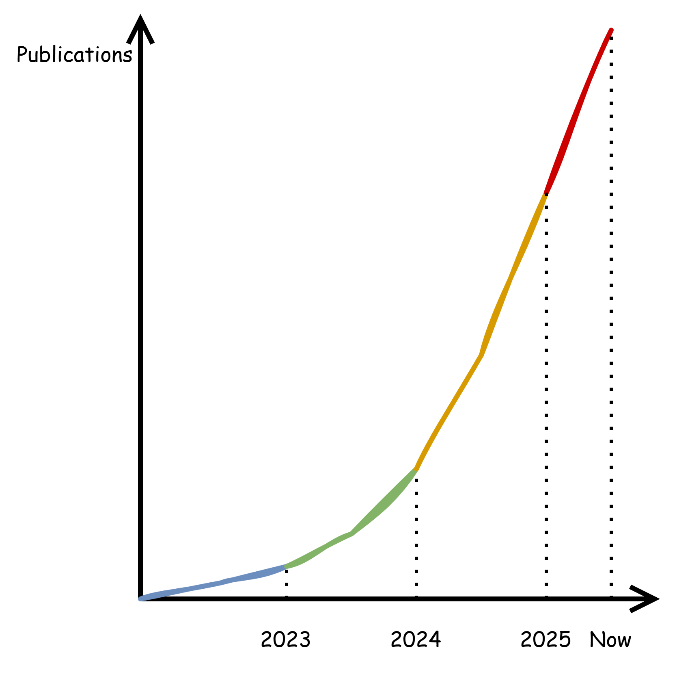
Situation
Researchers: When faced with overwhelming and complex literature, how should we cope?
Practitioners: where should we focus our efforts for innovation?
Both: How should we discuss them?
Notes:
面对纷繁复杂的工作，看不过来怎么办，到底应该对他们怎么分析，怎么定位，如果我们是一个开发者，我们应该在哪里进行创新。

Slide 7
Survey Overview
A Unified, Multi-Dimensional Taxonomy. (For Researchers and Practitioners)
We propose a four-axis taxonomy—what to scale, how to scale, where to scale, and how well to scale—that supports structured classification, comparison, and extensibility for TTS methods.
Systematical Literature Organization and Pragmatic Analysis. (For Practitioners)
Using our taxonomy, we survey the TTS landscape, analyze representative methods, and present guidelines for research application and deployment.
Challenges, Insights, and Forward Directions. (For Researchers)
Building on our organized perspective, we uncover critical challenges—ranging from advancing scaling to clarifying essence—and outline promising research directions that could shape future progress. Our unified framework facilitates the mapping of these open questions to concrete dimensions of TTS, enabling more targeted and impactful advancements.

Slide 8
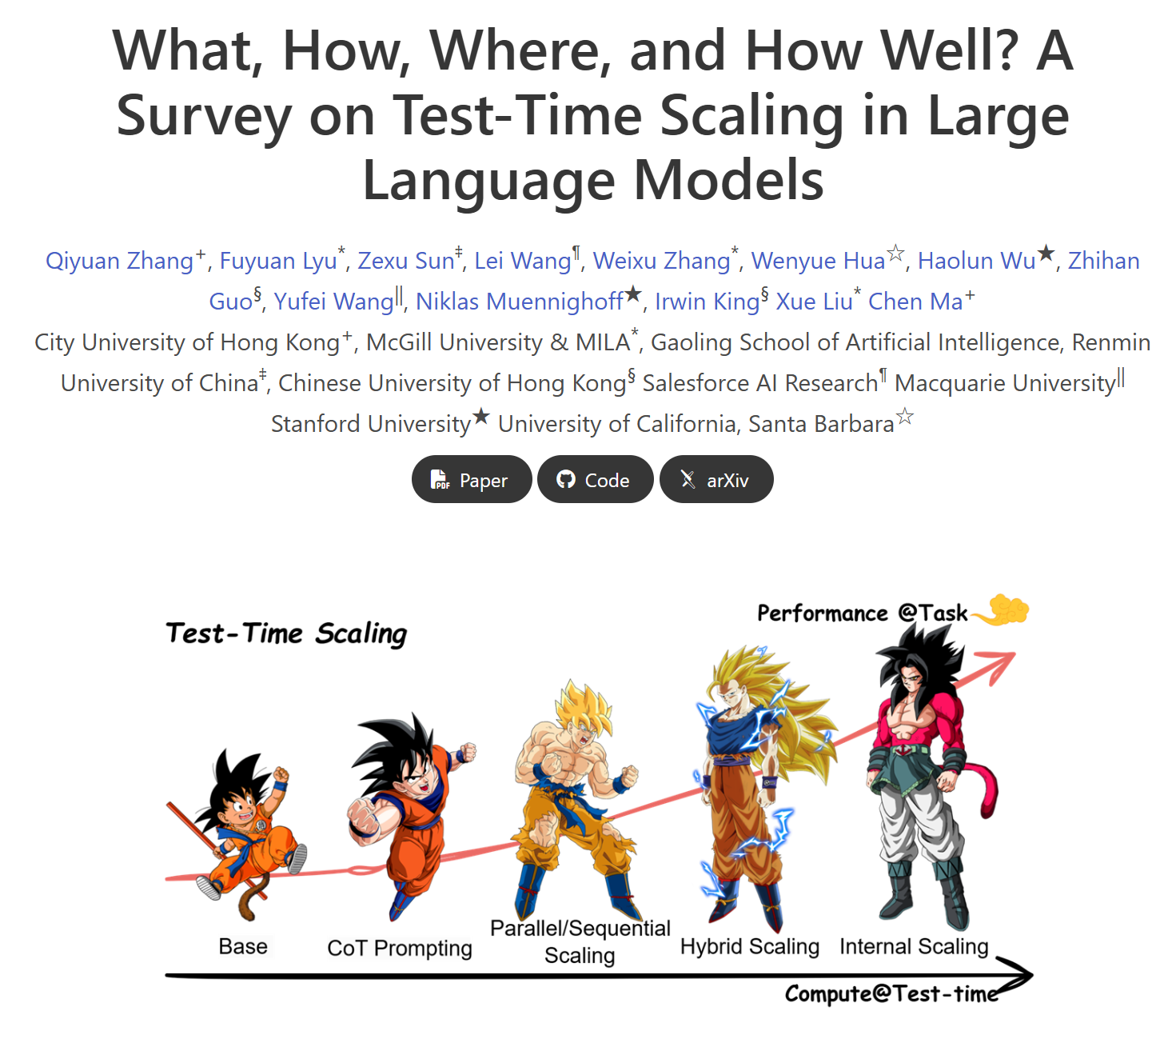

Slide 9
Dissecting TTS into 4 Key Orthogonal Dimensions
What to scale
refers to the specific form of TTS that is scaled to enhance an LLM’s performance during inference.
How to scale
TTS
depicts how different TTSs are implemented.
Where to scale
covers the tasks and datasets where these TTSs are applied.
How well to scale
refers to both the metrics of evaluating TTS and the optimization directions.
Taxonomy Credit to Yufei Wang

Slide 10
What to Scale
When applying TTS, researchers typically choose a specific empirical hypothesis.
e.g., longer CoT, multiple sampling, advanced search ...
Parallel Scaling
Generating multiple outputs in parallel.
Sequential Scaling
What to Scale
Updating intermediate states iteratively.
Hybrid Scaling
Balancing exploration and exploitation.
Internal Scaling
Determining autonomously how much computation to allocate.
Chapter Credit to Qiyuan Zhang

Slide 11

Parallel Scaling
Normal: LLMs generate a single response per query.
Parallel scaling
generates multiple outputs in parallel and then aggregates them into a final answer.
e.g. Best-of-N, Majority-Voting

Slide 12
Sequential Scaling
Normal: LLMs generate a single response per query.
Parallel scaling
generates multiple outputs in parallel and then aggregates them into a final answer.
e.g. Best-of-N, Majority-Voting
Sequential scaling
involves explicitly directing later computations based on intermediate steps.
e.g. Self-Refine, CoT

Slide 13
Hybrid Scaling
Normal: LLMs generate a single response per query.
Parallel scaling
generates multiple outputs in parallel and then aggregates them into a final answer.
e.g. Best-of-N, Majority-Voting
Sequential scaling
involves explicitly directing later computations based on intermediate steps.
e.g. Self-Refine, CoT
Hybrid scaling
exploits the complementary benefits of parallel and sequential scaling.
e.g. ToT, FoT, AoT, MCTS

Slide 14
Internal Scaling
Normal: LLMs generate a single response per query.
Parallel scaling
generates multiple outputs in parallel and then aggregates them into a final answer.
e.g. Best-of-N, Majority-Voting
Sequential scaling
involves explicitly directing later computations based on intermediate steps.
e.g. Self-Refine, CoT
Hybrid scaling
exploits the complementary benefits of parallel and sequential scaling.
e.g. ToT, FoT, AoT, MCTS
Internal scaling
Internalize the scaling process into a model and autonomously determine how much computation to allocate
e.g. R1, o1/o3

Slide 15
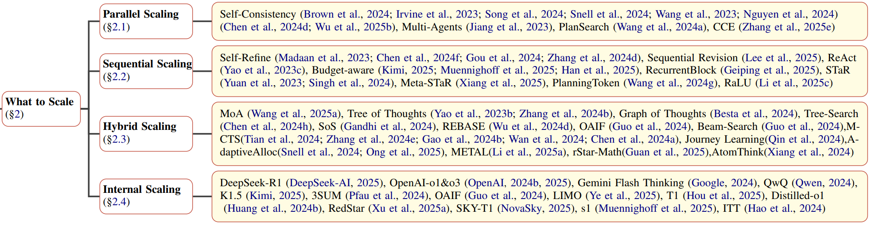
What to Scale - Taxonomy

Slide 16
How to Scale
Stimulation
Verification
Inference Strategies
Search
Aggregation
How to Scale
Supervised Finetuning
Tuning Strategies
Reinforcement Learning

Slide 17
Inference-based Approaches
Inference-based approaches dynamically adjust computation during deployment.
This paradigm includes 4 essential components:
Stimulation encourages the model to generate longer or multiple candidate outputs;
Verification filters or scores outputs based on correctness or other criteria;
Search systematically explores the sample space;
Aggregation consolidates multiple outputs into the final output.
Chapter Credit to Fuyuan Lyu

Slide 18
Inference-based Approaches: Stimulation
Stimulation encourages the model to allocate more computation to thinking.
Prompt Strategy
This behavior requires the backbone LLM’s ability to follow instructions.
Decode Strategy
This approach modifies the decoding process to encourage LLM to generate longer, more detailed samples adaptively.
Latent Strategy
It encourages deeper or recurrent thinking within the hidden representations themselves through continuous internal states.
Self-Repetition Strategy
It generates multiple samples instead of individual ones.
Mixture-of-Model Strategy
It requires gathering the “wisdom of the crowd”.

Slide 19
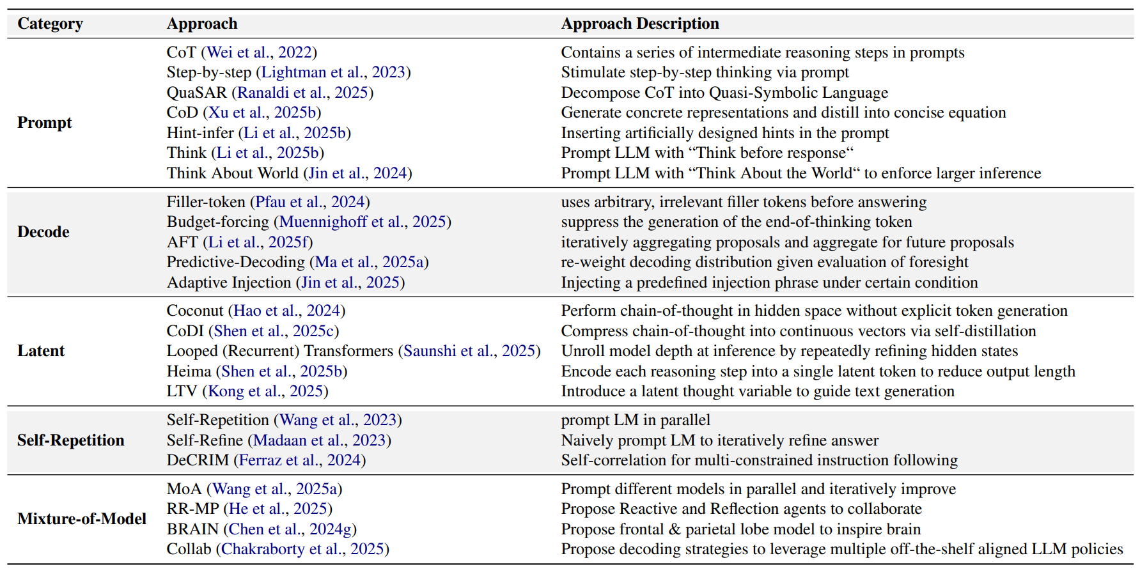
Summary of Certain Stimulation Techniques

Slide 20
Inference-based Approaches: Verification
The verification process plays an important role in the test-time scaling
• directly selects the output sample among various ones (Parallel Scaling);
• guides the stimulation process and determines when to stop (Sequential Scaling);
• serves as the criteria in the search process (Hybrid Scaling);
• determines what sample to aggregate and how to aggregate them, e.g., weights.
Outcome Verification.
plays a crucial role in ensuring the correctness and consistency of generated outputs.
Process Verification.
verifies the sample outcomes and the process of obtaining such an outcome.

Slide 21
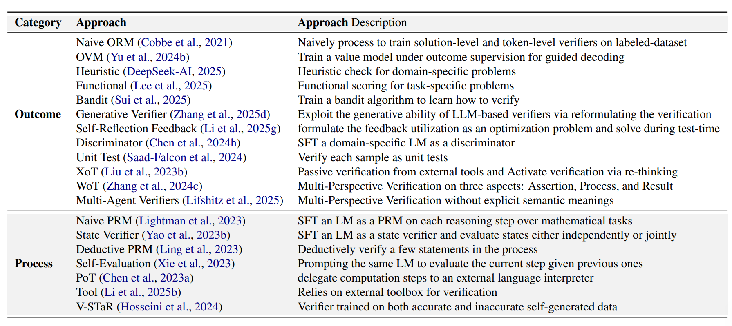
Summary of Certain Verification Techniques

Slide 22
Inference-based Approaches: Search
Employing search algorithms during inference provides a structured way to explore the solution space, significantly enhancing performance in complex tasks.
Beam Search and Variants
Beam search-based methods enhance traditional beam search by incorporating additional dimensions such as stochasticity, self-evaluation, and diversity.
Graph-Structured Search
They extend search strategies beyond simple tree structures, modeling outputs explicitly as graphs to exploit relational and complex structural reasoning.
Tree-Structured Search
These approaches leverage classical tree search algorithms to organize potential outputs into structured trees, explicitly exploring reasoning or planning steps.
Monte-Carlo Tree Search (MCTS)
Naive Tree Search Methods (e.g., DFS, BFS)
Systematic and Optimized Search Approaches
These works provide systematic analyses, optimizations, and enhancements to traditional search techniques, e.g., reward-balanced search.

Slide 23
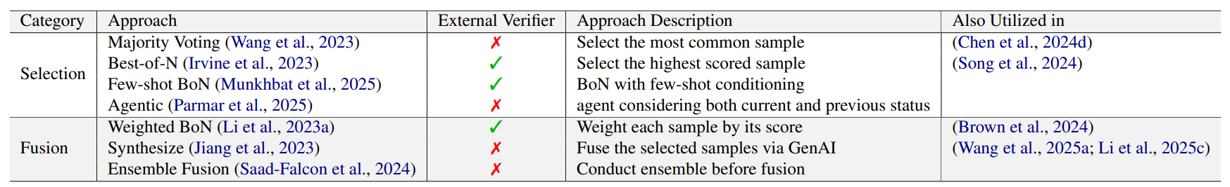
Inference-based Approaches: Aggregation
Aggregation techniques consolidate multiple solutions into a final decision to enhance the reliability and robustness of model predictions at test time.
Selection
selects the best-performed sample among all candidates, where the selection criteria may vary across different approaches.
Fusion
fuses multiple samples into one through tricks like weighting or generation.

Slide 24
Tuning-based Approaches
To activate a model’s ability to devote cost at test time, directly tuning its parameters is an effective strategy.
1) Supervised Finetuning (SFT)
Training an LLM via next-token prediction.
Key Factor: Data (synthetic or distilled long CoTs)
2) Reinforcement Learning (RL)
By leveraging feedback from a reward model on inference tasks, the policy model is automatically updated.

Slide 25
Tuning-based Approaches: SFT
Imitation
generate long CoT demonstrations using test-time “planner” algorithms and then fine-tune the model to imitate those demonstrations.
Distillation
aim to transfer the capabilities of a stronger model (or ensemble of models) into a target model via supervised learning.
Warmup
refer to an initial SFT phase applied to an LLM after its unsupervised pretraining but before other post-training steps like RL.
Chapter Credit to Haolun Wu

Slide 26
Tuning-based Approaches: RL
Reward Model-Free Approaches
These methods do not rely on explicitly learned reward models but instead use intrinsic or implicit signals to guide model optimization.
Representative works: rule-based reward, preference optimization, Value Function, Dynamic Sampling…
Open-Source Training Frameworks
SimpleRL, DeepScaler, SimpleRL-Zoo, X-R1, TinyZero, Open-Reasoner-Zero. OpenR, OpenRLHF, OpenR1, Logic-RL, AReaL.
Reward Model-Based Approaches
These methods explicitly utilize trained reward models, typically guided by human preferences or learned value models.
Representative works: Human-Preference Optimized Reward Models, Process-Based Reward Model, Enhanced Reward Models…
Chapter Credit to Zexu Sun

Slide 27
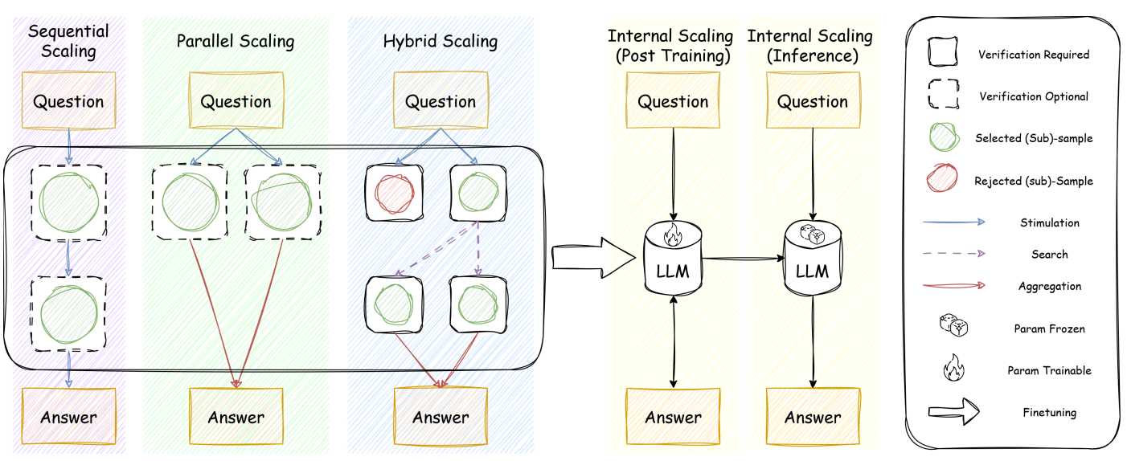
A Visual Map and Comparison:
From What to Scale to How to Scale.

Slide 28
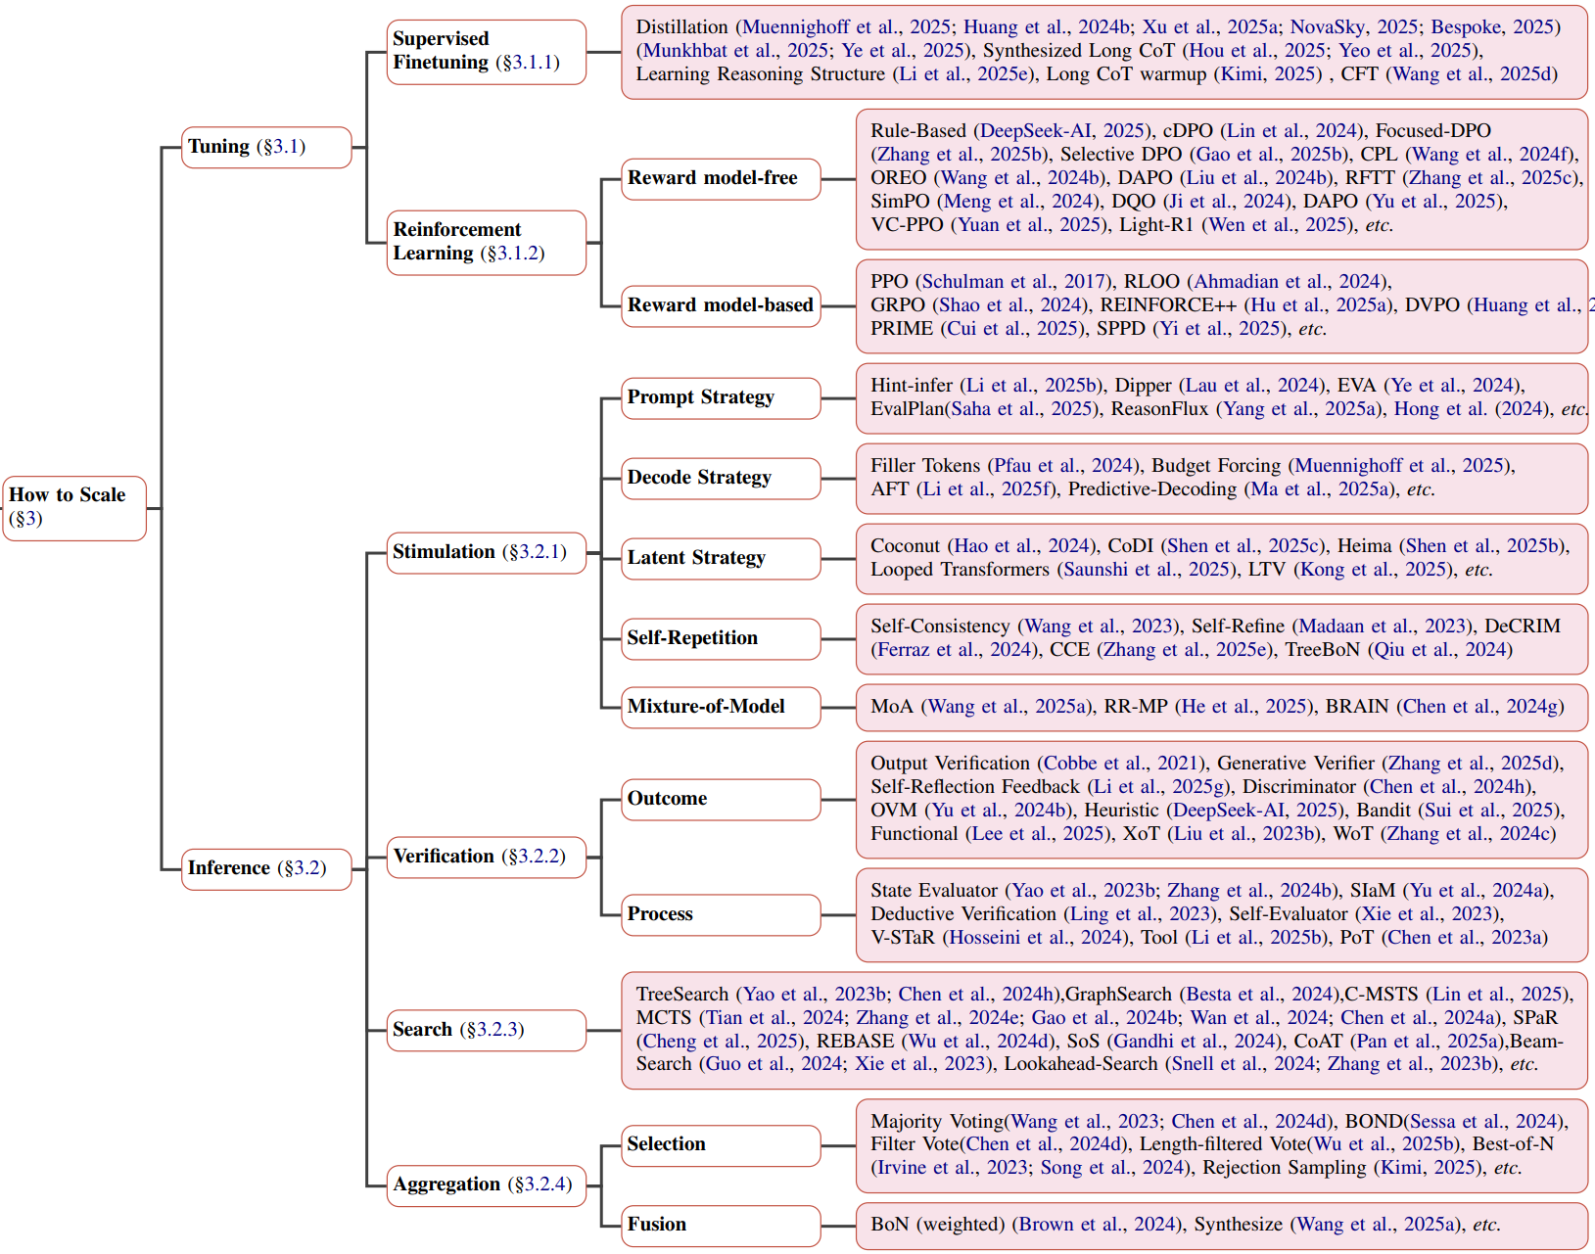
How to Scale - Taxonomy

Slide 29
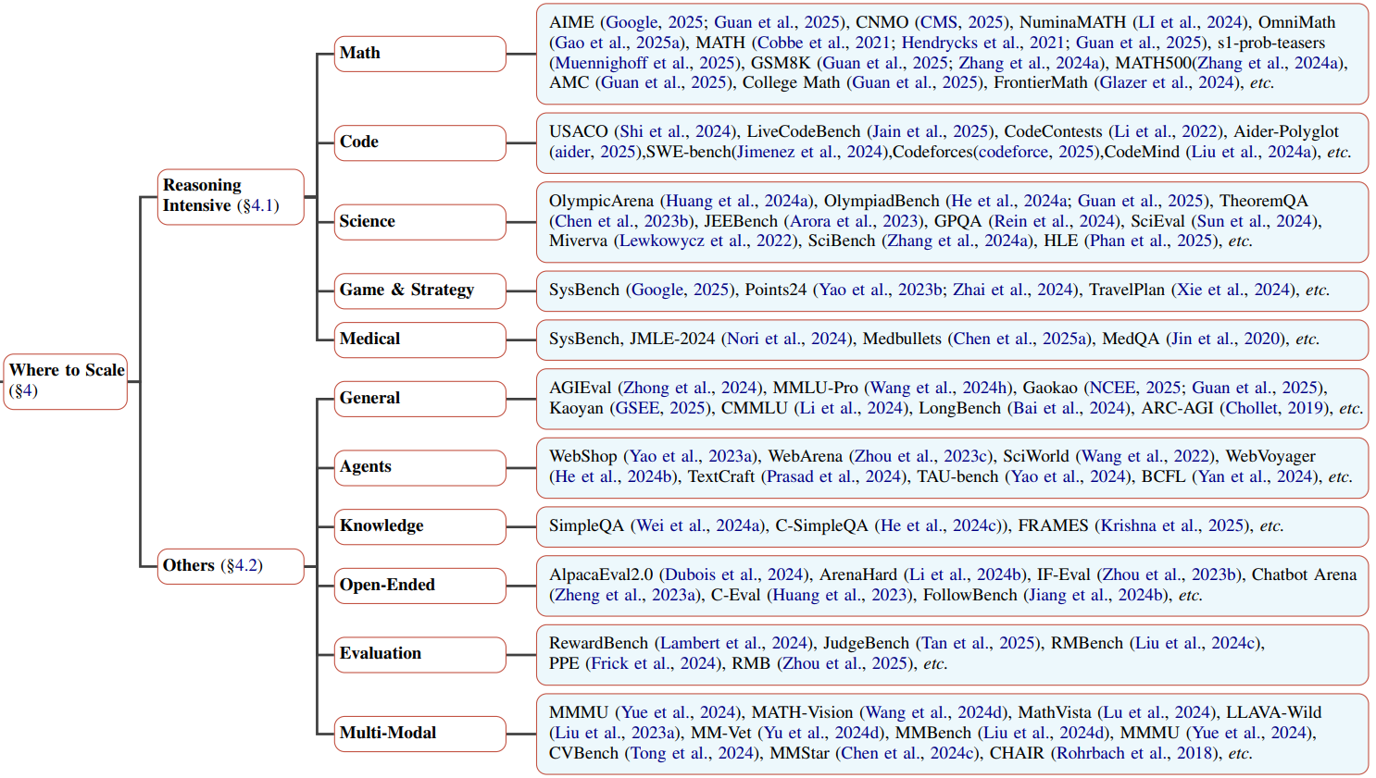
Where to Scale - Taxonomy
Chapter Credit to Weixu Zhang, Wenyue Hua & Zhihan Guo

Slide 30
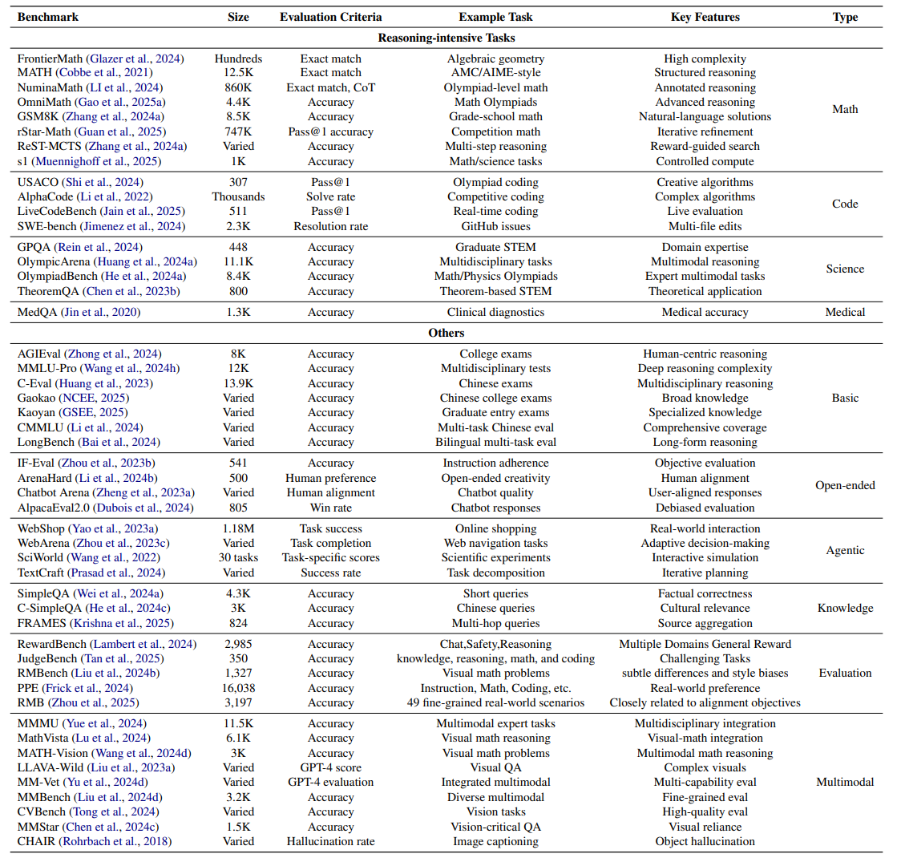
Summary of Benchmarks

Slide 31
How Well to Scale
Performance
assess the correctness of generated solutions.
Controllability
How Well to Scale
evaluate whether test-time methods can consistently adhere to pre-defined resource constraints (compute budgets or output length targets).
Scalability
measure how effectively test-time scaling methods can leverage increased compute to improve performance.
Efficiency
assess the computational and resource cost.
Chapter Credit to Lei Wang

Slide 32
How Well to Scale - Performance
Pass@1 evaluates the correctness of a model’s first output attempt, which is frequently used in tasks such as mathematical reasoning and coding benchmarks.
Pass@K extends Pass@1 by measuring whether at least one of the model’s k sampled outputs is correct, which is widely adopted in program synthesis and formal theorem-proving tasks.
Cons@k (Consensus@K) measures the majority vote correctness from k independently sampled outputs.
Pairwise Win Rate is based on comparing against baselines using human or LLM-based judges.
Task-Specific Metrics
For instance, Codeforces Percentile and Elo Rating.

Slide 33
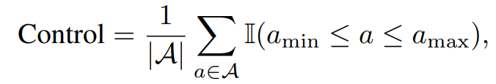

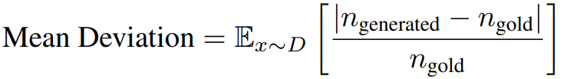
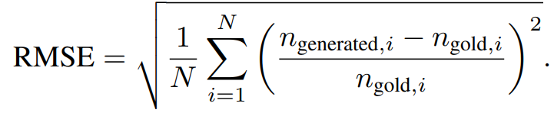
How Well to Scale - Controllability
Control Metric
measures the fraction of test-time compute values that stay within given upper and lower bounds.
where 𝒜 is the set of observed compute values such as thinking tokens, and (·) is the indicator function.
Length Deviation Metric
Mean Deviation from Target Length quantifies the average relative difference between the generated output length and the target length
Root Mean Squared Error (RMSE) of Length Deviation captures the variance in length control
k–ϵ Controllability
quantifies whether a model can be guided to produce a target output within a bounded prompt length and allowable deviation.

Slide 34
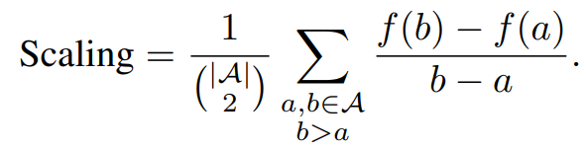
How Well to Scale - Scalability
Scalability metrics measure how effectively test-time scaling methods can leverage increased compute (e.g., token budgets, samples, inference steps) to improve performance.
Scaling Metric
captures the average slope of performance gains as compute increases
Scaling Curves (Accuracy vs. Compute)
visualizes how metrics such as accuracy, pass rate, or EM improve as token budgets, iteration depth, or the number of samples increase.

Slide 35
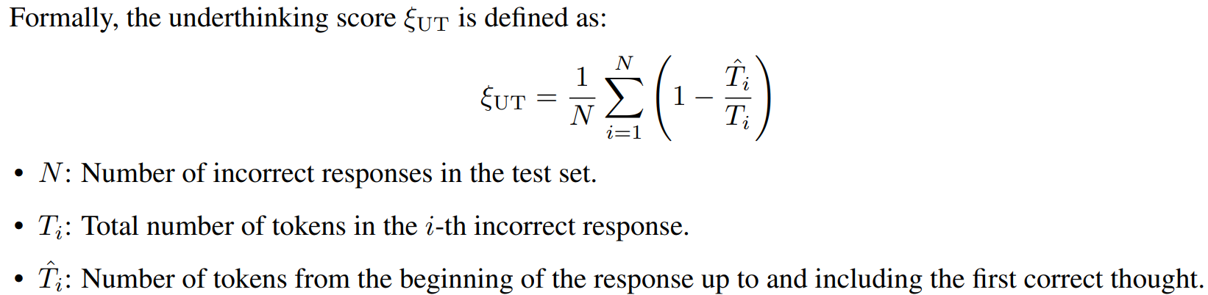
How Well to Scale - Efficiency
Token Cost
measures the total number of tokens generated during inference, including intermediate reasoning steps and final outputs.
FLOPs-based Efficiency Analysis
Underthinking score
measures how early in the response the first correct thought appears, relative to the total length of the response, in cases where the final answer is incorrect.

Slide 36
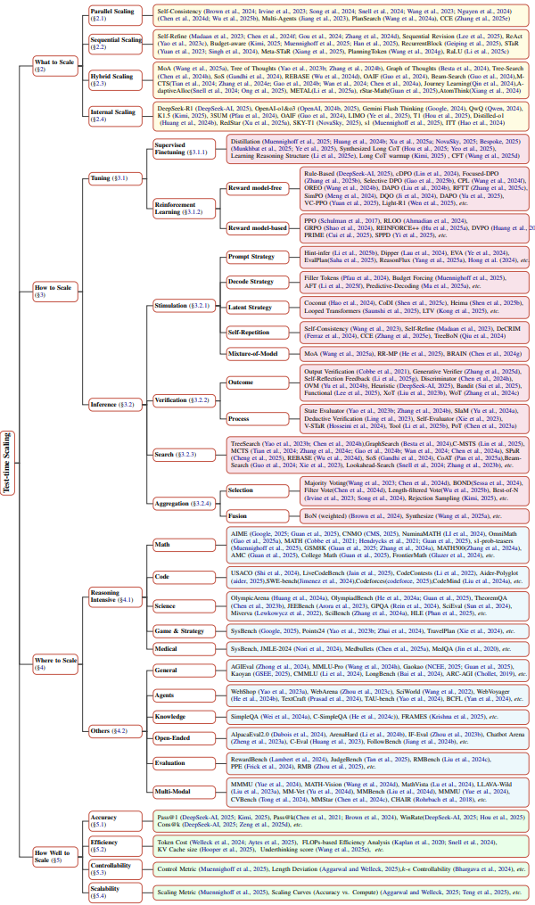
Taxonomy

Slide 37
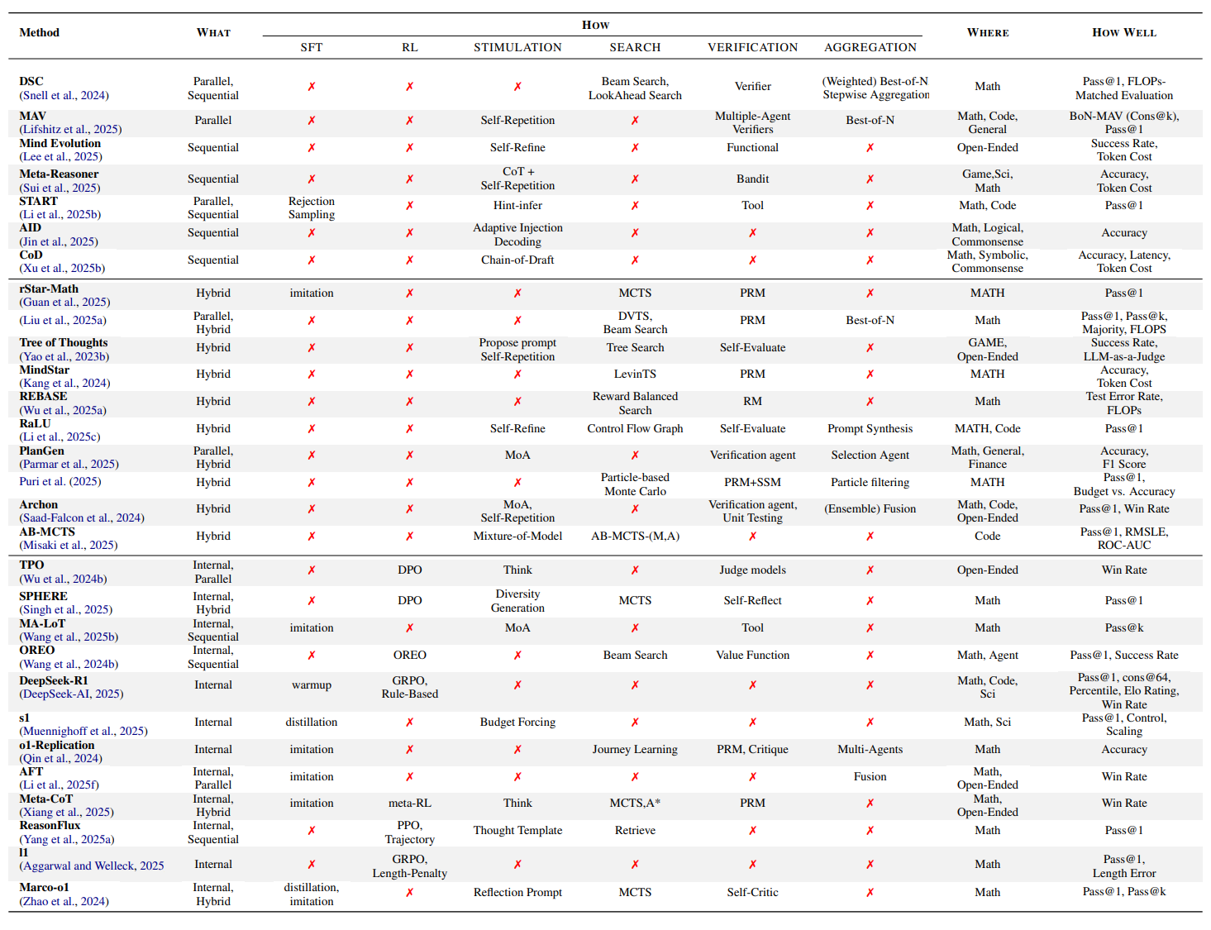
Existing Literature Organization using Our Taxonomy

Slide 38
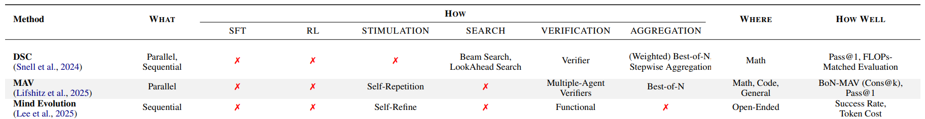

Slide 39
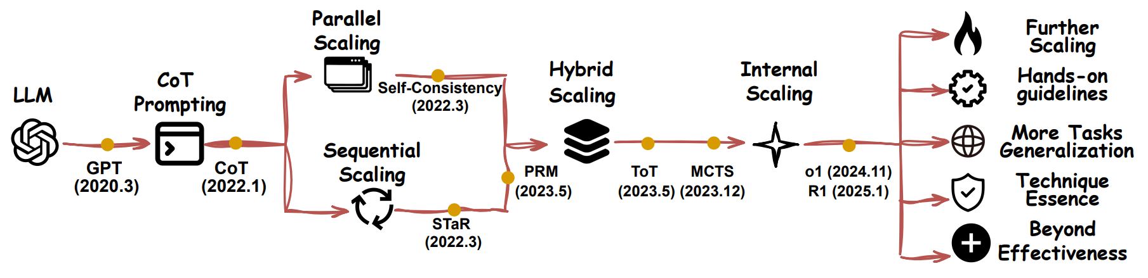
Organization and Trends in Test-time scaling
These techniques are complementary
There is no one simple scaling solution that works for all problems
The boundary between inference-based and tuning-based approaches is blurring.
Chapter Credit to Qiyuan Zhang

Slide 40
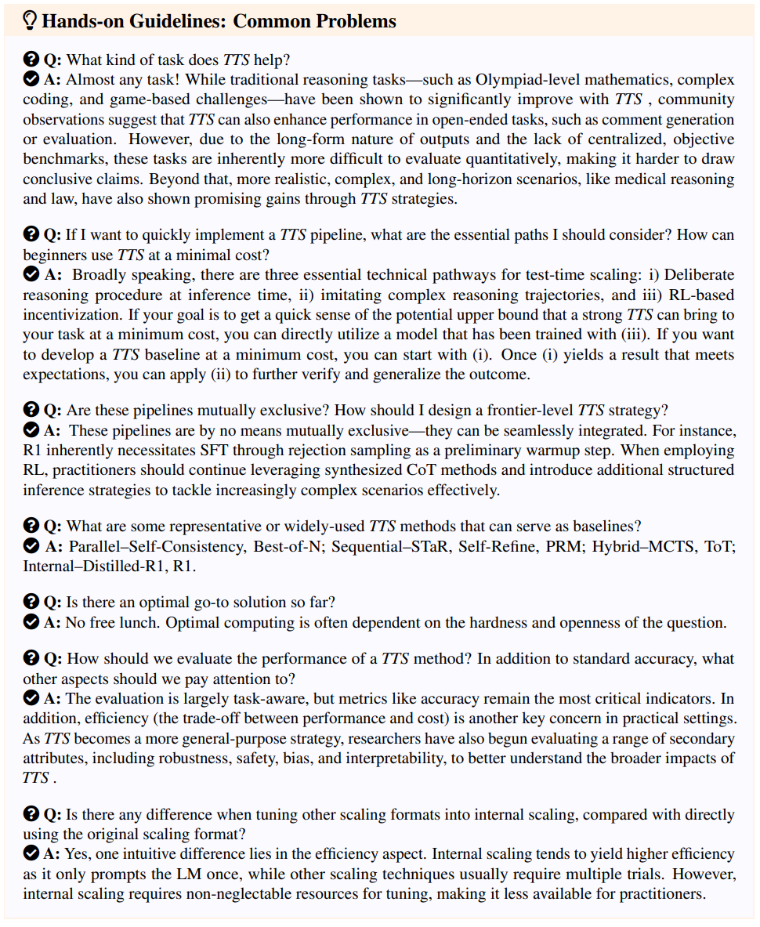
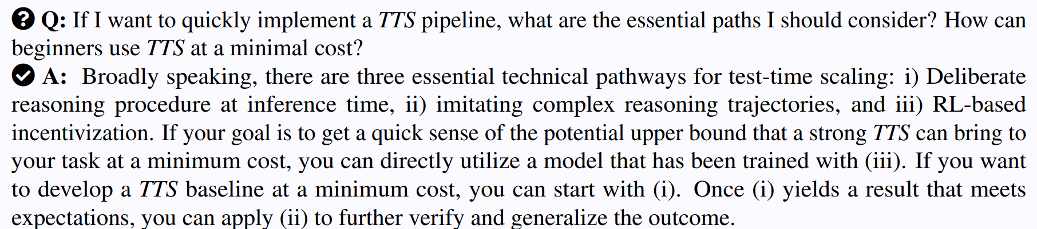
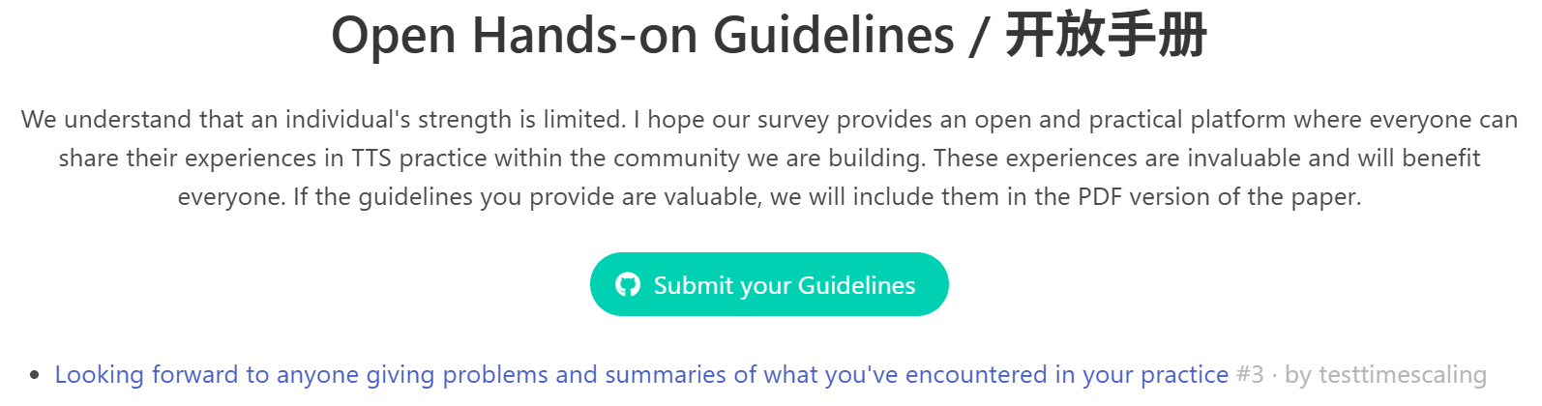
A Hand-on Guideline for Test-time Scaling

Slide 41
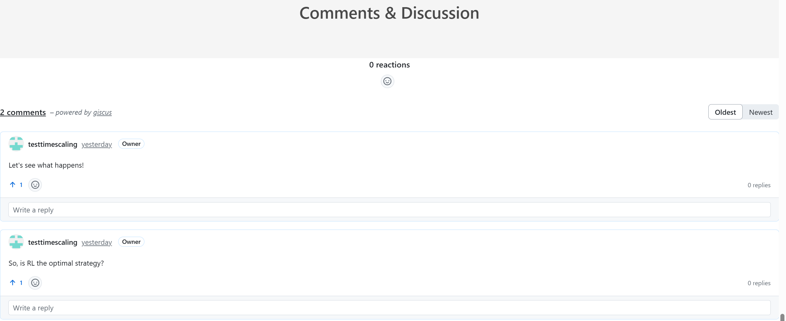
Open Comments supported by Our Page

Slide 42
Challenges and Opportunities
Advancing Scalability is the Frontier.
Clarifying the Essence of Techniques in Scaling is the Foundation.
Optimizing Scaling is the Key
Generalization across Domains is the Mainstream

Slide 43
More Scaling is the Frontier
Parallel Scaling
Sequential Scaling
Challenges:
- Diminishing returns at saturation
- Naive best-of-N lacks diversity
Opportunities:
1. Smart Coverage Expansion: Diverse reasoning paths
2. Verifier-Augmented Sampling: Real-time filtering
Challenges:
- Coherence degradation
- Error accumulation
Opportunities:
1. Structured Self-Refinement: Targeted step repair
2. Verification-Enhanced Iteration: Real-time consistency checks
Hybrid Scaling
Internal Scaling
Generalized Hybrid Scaling Architectures
Effective Compute Allocation
Multi-Agent & Interactive Scaling
Stability and Consistency
Interpretability and Controllability

Slide 44
Clarifying the Essence
Their roles and interactions within the pipeline demand a deeper investigation.
Theoretical Gaps in Scaling Techniques
How do core techniques (SFT, RL, reward modeling) contribute to test-time scaling? how should SFT and RL be optimally combined?
Re-evaluating Reward Modeling
whether PRMs actually improve multi-step inference? Does the classic reward model incorporate noise and unnecessary complexity?
Mathematical Properties of Test-Time Scaling
How does performance scale with increased inference steps? Is there an optimal stopping criterion? Are there fundamental constraints on how much test-time scaling can improve reasoning performance?

Slide 45
Clarifying the Essence
Chain-of-Thought Reasoning Priorities
Which aspects of the chain-of-thought are most crucial for effective test-time scaling?
Adaptive Test-Time Scaling
How can we make a model automatically adjust its inference process based on the problem at hand? As empirical observations on certain property models show blindly scaling over test-time may lead to over-thinking.
Thoughtology
How do the reasoning patterns in its language help improve reasoning effectiveness by treating a finetuned reasoning model as an agent?

Slide 46
Optimizing TTS via Metrics
Goal: Holistic evaluation & efficient deployment
Directions to Optimize:
- Accuracy
- Efficiency
- Robustness
- Interpretability
- Bias/Safety
Trend: Multi-metric, task-sensitive optimization strategies emerging

Slide 47
Domain Generalization
Challenges:
Balancing Cost and Accuracy:
Unlike general NLP tasks, specialized domains often require strict computational efficiency and reliability;
Ensuring Domain-Specific Interpretability:
In fields like medicine and law, outputs must be transparent and justifiable;
Integrating External Knowledge & Real-World Constraints:
Many domains require retrieval-augmented generation, real-time data analysis, or interactive query refinement;
4. Future research must identify generalizable test-time scaling strategies that are robust across diverse reasoning tasks.
Emerging Domains:
Medicine
Finance
Law
Math Proof & Physics
AI Evaluation
open-domain QA
other high-stakes or knowledge-intensive areas

Slide 48
Conclusion
In the post-training era, TTS has been one of the dominant directions.
a. Structured Taxonomy
b. Practical Utility
c. Open Community

Slide 49


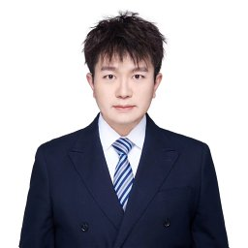










Our Amazing and Inspiring Team
Qiyuan Zhang @CityU
Fuyuan Lyu
@McGill & MILA
Zexun Sun
@Gaoling RUC
Lei Wang
@Saleforce AI
Weixu Zhang
@McGill & MILA
Wenyue Hua
@UCSB
Haolun Wu
@Stanford & McGill & MILA
Zhihan Guo
@CUHK
Yufei Wang
@Macquire
Niklas Muennighoff @Stanford
Irwin King
@CUHK
Steve Liu @MBZUAI & McGill & MILA
Chen Ma @CityU

Slide 50
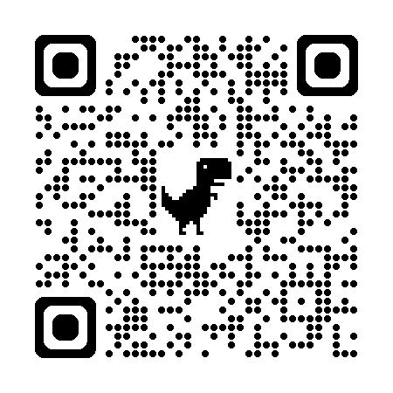

Thanks for the invitation and your watching!
Page: https://testtimescaling.github.io/
Email: qzhang732-c@my.cityu.edu.hk
fuyuan.lyu@mail.mcgill.ca
paper

